Slide 1
ATOMIC STRUCTURE
Unit 1 – Lessons 1 & 2

Slide 2
ATOMIC STRUCTURE TIME!

Slide 3
REVIEW: What’s the Matter?
Matter – anything that has mass and volume …IN OTHER WORDS…
EVERYTHING IS MATTER!
There are 3 basic States of Matter…what are they?
Solid, Liquid & Gas

Slide 4
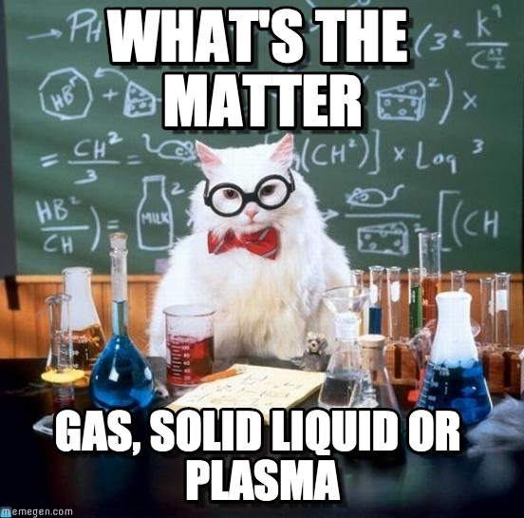
How do the particles move in each of these states?
Act it out!

Slide 5
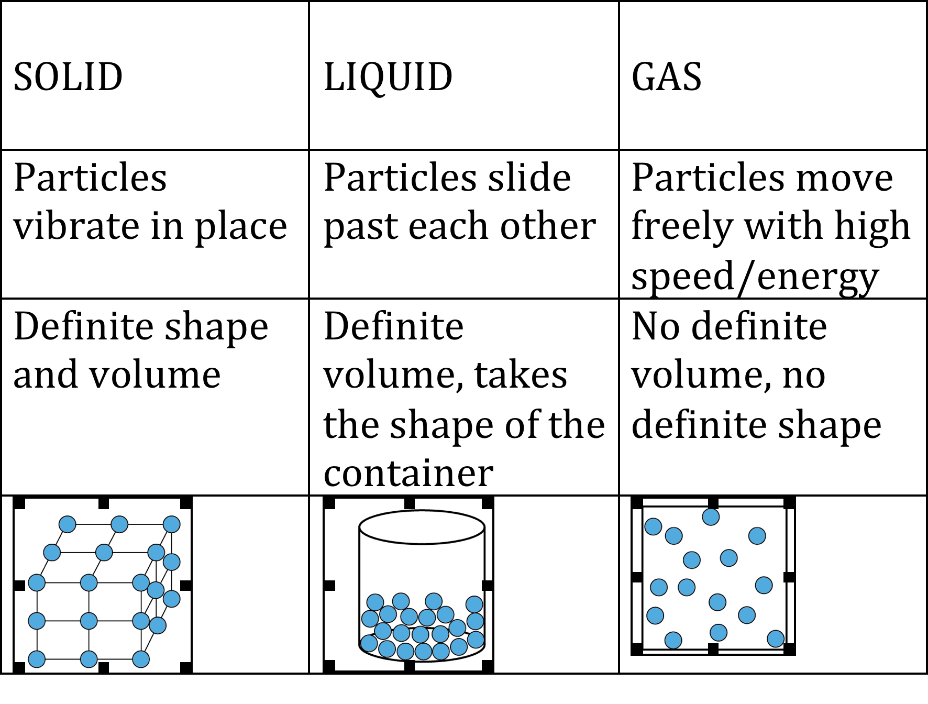
Structure & States of Matter
What happens if you increase or decrease the temperature?

Slide 6
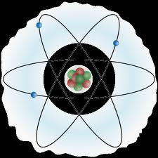
Big Idea 1…Atoms
All matter is made up of atoms
So what’s an atom?
An atom is the smallest part of whatever it makes up

Slide 7
Big Idea 2...Elements
Atoms make up elements
So what’s an element?
Elements are pure substances that are made up of only one type of atom
(There are about 100 different elements & each element is made of it’s own unique atom)

Slide 9
Big Idea 3…Atomic Structure
Atoms are made of even smaller parts, referred to as subatomic particles
So what are these subatomic particles of an atom called?
Protons, Neutrons & Electrons

Slide 10
Protons & Neutrons (Protons & Neutrons are about the same size and mass)
Protons
Neutrons
Protons have a positive charge
Neutrons have no charge (neutral)
BOTH are found inside of the NUCLEUS Nucleus = the center of the atom

Slide 11
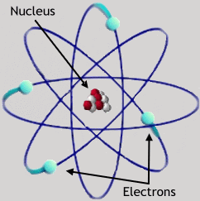
Electrons
Electrons have a negative charge
Electrons are MUCH smaller than protons or neutrons
Electrons orbit the nucleus on paths called energy levels or shells

Slide 12
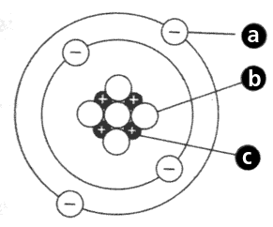
What Does An Atom Look Like?
Where is the nucleus?
What do letters a, b & c represent?

Slide 13
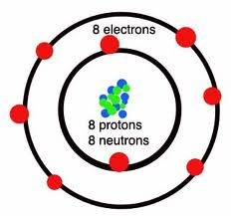
Bringing it all together… For example, OXYGEN is an element on the periodic table. All NEUTRAL atoms of oxygen are the same!
Actual Oxygen Atom
How Oxygen is represented on the Periodic Table

Slide 14
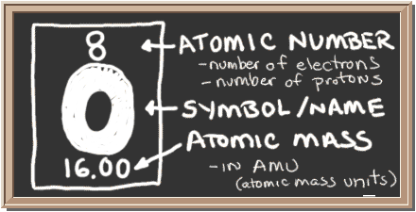
Oxygen Again…
Atomic Number = - The number of protons
- The number of electrons
Atomic Mass = The number of protons + number of neutrons inside the nucleus

Slide 15
Quick Trick
Atomic Number =
Protons
Electrons
Mass -
Atomic Number =
Neutrons
Who helps you figure out the number of protons, electrons and neutrons in an atom…the APE MAN of course!

Slide 16
PRACTICE
Atomic Number
Atomic number equals the number of ____________ or ________________.
Atomic mass equals the number of ______________ + _______________.
Symbol
Name
Atomic Mass

Slide 17
USE THE PERIODIC TABLE ON PAGE 143 TO HELP YOU WITH THE NAMES AND SYMBOLS OF THE ELEMENTS!!

Slide 22
The Atoms Family

Slide 23
The Atoms Family from Matterville
In the center of Matterville, there is a place called the Nucleus Arcade, where two members of the Atoms Family like to hang out. Perky Patty Proton, like her sisters, is quite large with a huge smile and eyes that sparkle (+). Patty is always happy and has a very positive personality. Nerdy Nelda Neutron is large like Patty, but she has a boring, flat mouth and eyes with zero expression (o). Patty, Nelda, and their sisters spend all their time at the arcade.
Name:
Patty Proton
Description:
Positive
Favorite Activity:
Hanging out at the Nucleus Arcade
Name:
Nelda Neutron
Description:
Neutral
Favorite Activity:
Hanging out at the Nucleus Arcade

Slide 24
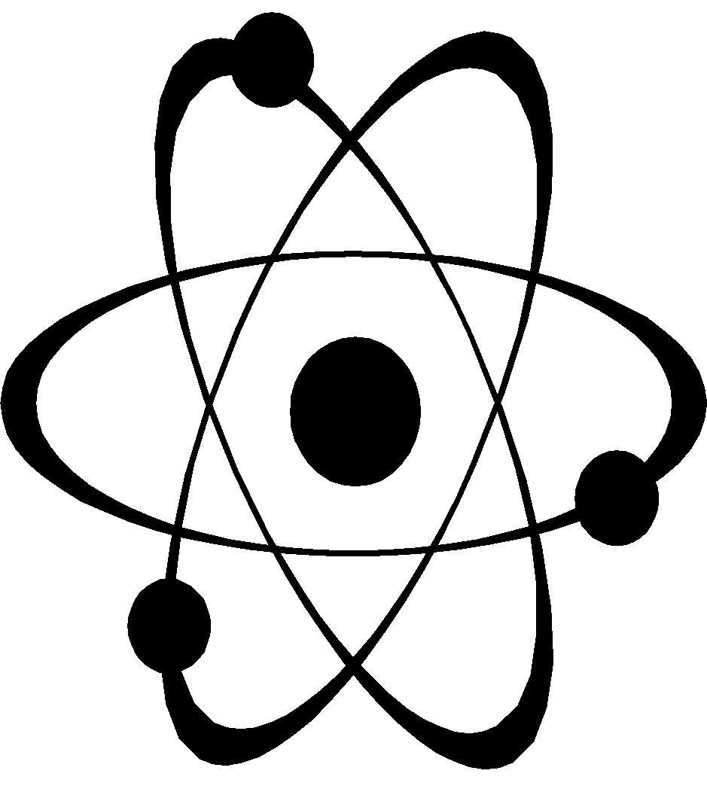
Around the Nucleus Arcade, you will find a series of roadways that are used by the brothers in the Atoms Family. Elliott Electron races madly around the Arcade on his go-kart. Elliott is much smaller than Patty and Nelda and he is always angry because his big sisters will not let him into the Arcade. He has a frown on his face, eyes that are squinted with anger, and a very negative (-) attitude. Elliot and his brothers are forced to hang out on the streets outside the arcade.
Name:
Elliott Electron
Description:
Negative
Favorite Activity:
Racing around the arcade

Slide 25
REMEMBER: The Electrons are only allowed on the streets around the arcade. The first “street” can only hold 2 Electron brothers. The second “street,” can hold 8 brothers. The third “street,” can hold up to 18 brothers.
Matterville
3rd “street” can hold 18 electrons
2nd “street” can hold 8 electrons
1st “street” can only hold 2 electrons
Nucleus Arcade Contains protons & neutrons

Slide 26
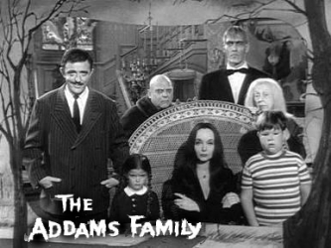
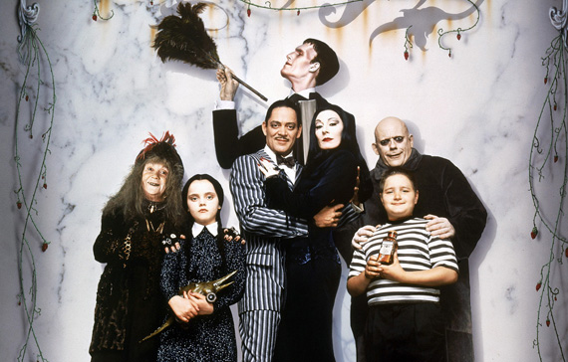
The Addams Family
Brain Break!
https://www.youtube.com/watch?v=Le9a8C0Pk2c

Slide 27
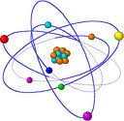
REVIEW… Everything is matter!
Matter is anything that has mass and volume

Slide 28
Matter is made of elements!
Which means everything is made of elements!
Oxygen
Carbon
Hydrogen
Silicon

Slide 29
Elements are made of atoms!
Each element is a different, unique atom! SO…everything is made of atoms!
Oxygen
Carbon
Hydrogen
Silicon

Slide 30
REVIEW- ball toss!
OK, SO WHAT IS AN ATOM?
PROTON?
NEUTRON?
ELECTRON?
ATOMIC NUMBER?
ATOMIC MASS?

Slide 31
REVIEW
HOW DO YOU KNOW IF SOMETHING IS AN ELEMENT OR NOT?

Slide 32
Bell work 9/12
Draw the square below and fill in the blanks.

Slide 33
The Moral of Matterville
PART 1:
MATTERVILLE IS NEUTRAL AS LONG AS EVERY ATOM HAS THE SAME NUMBER OF PROTONS (+) AND ELECTRONS (-) TO MAINTAIN A BALANCED CHARGE!
BUT WHAT HAPPENS WHEN THEY DON’T…?

Slide 34
Changing the # of Protons = Different Element
The number of protons determines what element it is – like an ID #
SO…changing the number of protons results in a different element!
It could make the element unstable or radioactive!

Slide 35
Matterville is neutral as long as each negative Electron brother is balanced out by one positive Proton sister.
Challenge: What would happen in Matterville if one Electron brother was kidnapped?

Slide 36
Challenge 2: What would happen in Matterville if Electron Eddie, a cousin, moved to Matterville?

Slide 37
Changing the # of Electrons = Ions
Ions are atoms that have a charge
Ions form when an atom gains or loses electrons
Gain an electron = negative charge = anion
Lose an electron = positive charge = cation
Why would an atom want to gain or lose electrons…hmmm?

Slide 38
Changing the # of Neutrons = Isotopes
Isotopes are atoms of the same element that have a different number of neutrons.
Adding or losing a neutron is like gaining or losing weight…same identity, different mass!
(Remember, neutrons have NO charge, but they are large like protons, so when you gain or lose them it ONLY affects the mass!)

Slide 39
Practicing Atomic Changes

Slide 40
The Atoms Family
…CONTINUED

Slide 41
The outermost shell or “street” is called the valence shell. The electrons on that shell are called valence electrons. The atom wants it’s valence shell to be full so that it is stable and happy.
Matterville
3rd “street” can hold up to 18 electrons
2nd “street” can hold 8 electrons
1st “street” can only hold 2 electrons

Slide 42
The Moral of Matterville
PART 2:
MATTERVILLE IS STABLE AS LONG AS ALL OF THE VALENCE SHELLS ARE FULL!
BUT HOW DO WE KNOW IF THEY ARE FULL?

Slide 43
We Need to Learn to Draw an Atom for Each Element:
Bohr Model: How many electrons?
FILL ONE SHELL AT A TIME, AND ONLY DRAW ANOTHER
SHELL IF YOU NEED IT!
Step 1: Draw the Nucleus
Step 4: Draw the 3rd shell etc. until all of the electrons for that specific element are on a shell
Step 2: Draw the 1st shell and fill it
Step 3: Draw the 2nd shell and fill it

Slide 44
BOHR DIAGRAMS…
LET’S DO HELIUM (He) TOGETHER

Slide 45
BOHR DIAGRAMS white board practice!
Try Oxygen on your own!

Slide 46
BOHR DIAGRAMS white board practice!
TRY SODIUM (Na) ON YOUR OWN!

Slide 47
BOHR DIAGRAMS white board practice!
TRY NEON (Ne) ON YOUR OWN!

Slide 48
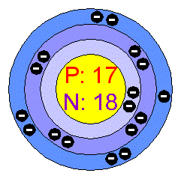
What if I give you the Bohr diagram? How do you figure out which element this is?

Slide 49
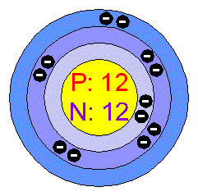
Which element this is?

Slide 50
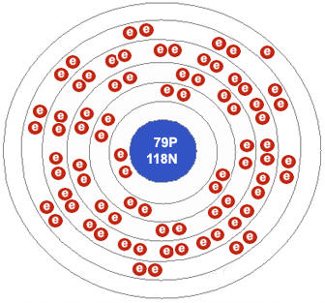
Which element this is?

Slide 51
Questions?

Slide 52
The Moral of Matterville
MATTERVILLE IS NEUTRAL AS LONG AS THE ATOMS HAVE THE SAME NUMBER OF PROTONS (+) AND ELECTRONS (-) SO THE TOWN HAS A BALANCED CHARGE!
MATTERVILLE IS STABLE AS LONG THE VALENCE SHELLS ARE FULL!

Slide 53
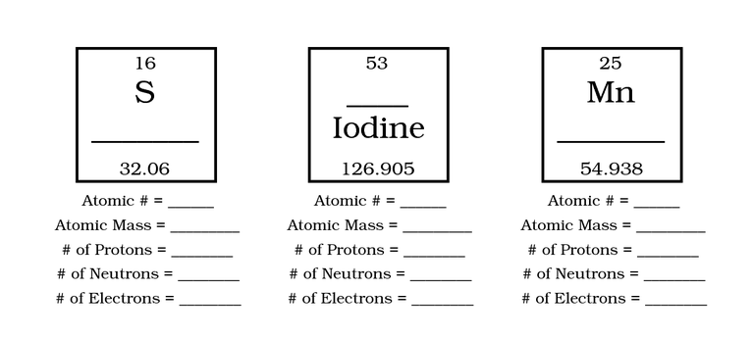
REVIEW

