Slide 1
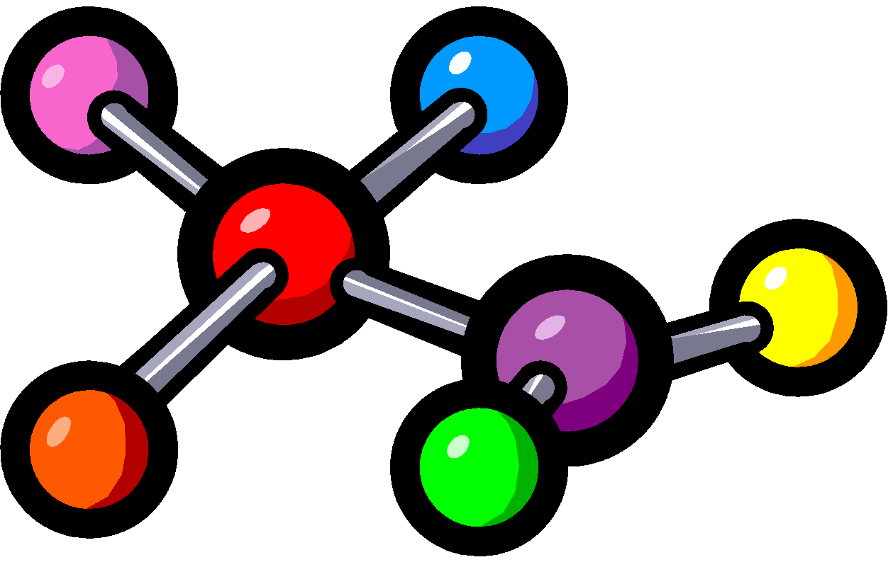
Bonding Basics
PART I

Slide 2
Bonding Basics
Bonding is an example of a chemical change
Bonding occurs when 2 or more atoms are chemically joined
When 2 or more atoms bond that is called a molecule
A molecule that contains 2 or more elements is called a compound

Slide 3
REVIEW: Bonding is ALL about….
VALENCE ELECTRONS =
the electrons on the outer (valence) shell of an atom

Slide 4
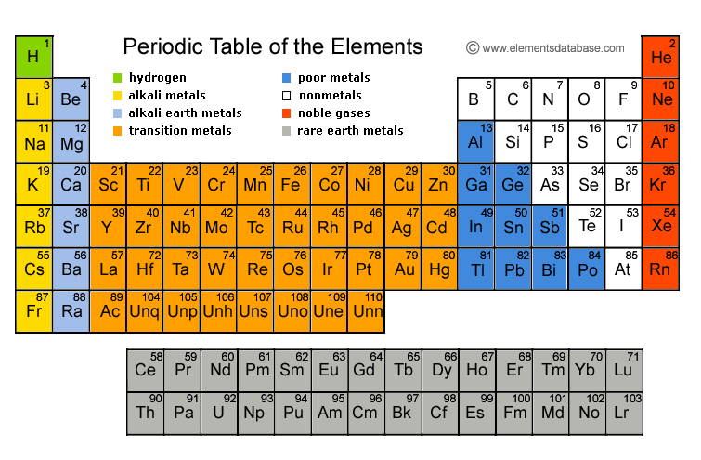
Valence Electrons:
8
7
1
2
3
4
5
6

Slide 5
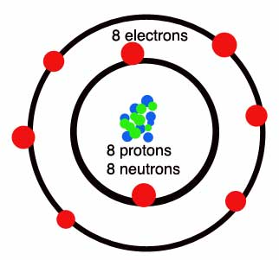
There are 2 ways to represent the # of Electrons:
Shows ALL electrons
Shows ONLY valence electrons
O
Bohr Diagram
Lewis Dot

Slide 6
How many electrons makes the valence shell full or stable/“happy”?
The first shell holds2electrons.
After the 1st shell, each shell needs8 electrons to be full and STABLE/HAPPY!

Slide 7
The Octet Rule
Atoms give away or steal electrons in order to happy and stable with a full valence shell!
Atoms with less than 4 valence electrons tend to lose electrons.
Atoms with more than 4 valence electrons tend to gain electrons.

Slide 8
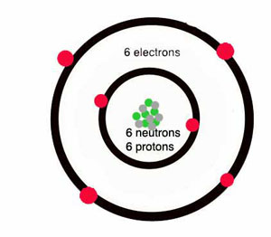
EXAMPLES…
What about an element like carbon?
Carbon has 4 valence electrons, so what will it do? BOTH!
The fact that carbon
has 4 valence electrons
allows it to bond with
many elements!

Slide 9
Reminder:
Atoms give away or steal electrons in order to be STABLE/HAPPY with a full valence shell!
REMEMBER: When an atom gains or loses electrons it becomes a charged ____________________
Ion (cation or anion)

Slide 10
Remember…
ION = an atom with a charge because it loses or gains one or more electrons.
Positive ion=cation
loses electrons
(now has more positive particles than negative)
Negative ion=anion
gains electrons
(now has more negative particles than positive)
Notes:
http://www.brainpop.com/science/matterandchemistry/ions/

Slide 11
EXAMPLES…
Here are 2 elements that have a few extra electrons. What do they want to do?

Slide 12
EXAMPLES…
Here are 2 elements that are missing a few electrons. What do they want to do?

Slide 13
EXAMPLES…
We have Sodium (Na) who has an extra electron, and Fluorine (F) who is looking for an electron SO…
They end up bonding so they can both be happy!

Slide 14
Let’s Try It!
Fill in the electron table using your periodic table…if you got that move on to the back!

Slide 15
Element | Element Symbol | Atomic Number | Total # of Electrons | # of Valence Electrons | # of Electrons Gained or Lost | Overall Charge (+/-)
Chlorine
Potassium
Magnesium
Fluorine
Aluminum
Carbon

Slide 16
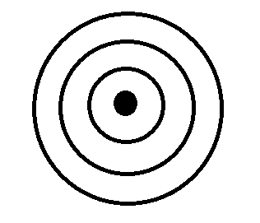
Atomic # =
Atomic Mass =
# of Protons =
# of Neutrons =
# of Electrons =
Cation/Anion =
Atomic # =
Atomic Mass =
# of Protons =
# of Neutrons =
# of Electrons =
Ion Symbol =

Slide 17
Bonding Basics
PART 2

Slide 18
Two Types of Chemical Bonds
Ionic Bonds
Covalent Bonds

Slide 19
Ionic Bonds
TRANSFER
Atoms will ____________ one or more electrons to another atom to form the bond.
Each atom is left with a ________________ valence shell.
An ionic bond forms between a ___________ion with a positive charge and a ________________ ion with a negative charge.
COMPLETE
METAL
NONMETAL

Slide 20
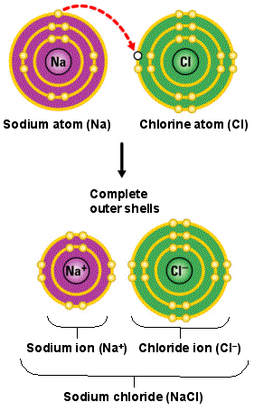
Ionic Bonds

Slide 21
Ionic Bonds
Li
F

Slide 22
Covalent Bonds
SHARE
Atoms ___________ one or more electrons with each other to form the bond.
Each atom is left with a ________________ valence shell.
A covalent bond forms between two ________________.
COMPLETE
NONMETALS

Slide 23
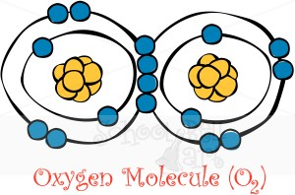
Covalent Bonds
=
=

Slide 24
Covalent Bonds
H
O
H

Slide 25
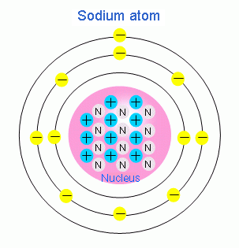
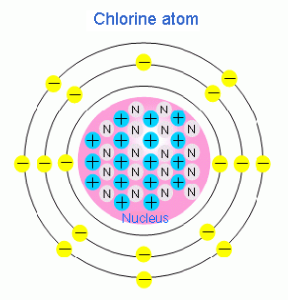
Ionic or Covalent Bond?

Slide 26
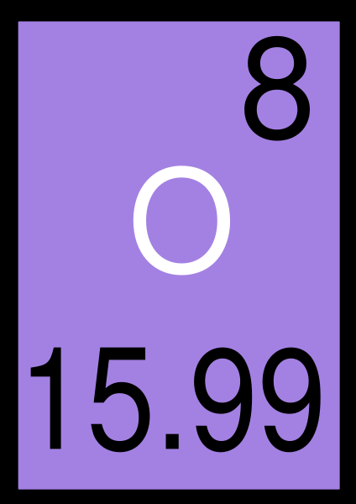
Ionic or Covalent Bond?

Slide 27
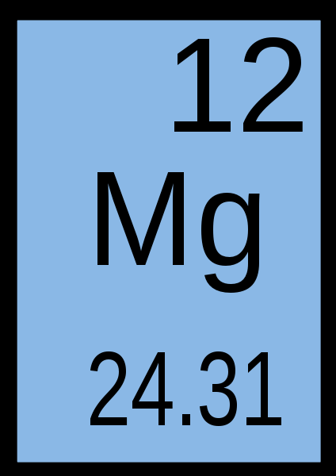
Ionic or Covalent Bond?

Slide 28
Ionic or Covalent Bond?
Bromine
Iodine

Slide 29
Ionic or Covalent Bond?
Calcium
Chlorine

Slide 30
Bonding Quiz:
1. After the first shell, each electron shell needs how many electrons to be stable/“happy” and complete?
A. 8
B. 2
C. 4
D. 18

Slide 31
Bonding Quiz:
2. The picture below is a Bohr diagram of an Oxygen (O) atom. Which of the following is TRUE about Bohr diagrams?
A. The Bohr diagram shows ONLY
valence electrons.
B. The Bohr diagram shows ALL
electrons, not just valence
electrons.
C. The Bohr diagram shows ONLY
protons.
D. The Bohr diagram shows ONLY
neutrons.

Slide 32
Bonding Quiz:
3. Draw the Lewis Dot diagram for Oxygen (O):

Slide 33
Bonding Quiz:
4. How many valence electrons does Neon (Ne) have?
A. 5
B. 4
C. 8
D. 1

Slide 34
Bonding Quiz:
5.Sodium (Na) is stable/“happy” because it has a full valence shell.
A. True
B. False

Slide 35
Bonding Quiz:
6. Which type of bond is between a metal and a nonmetal?
A. Covalent
B. Ionic

Slide 36
Bonding Quiz:
7. ____________ bonds involve transferring electrons to be stable/“happy” or complete.
A. Ionic
B. Covalent

Slide 37
Bonding Quiz:
8. A _______________ bond is between two or more nonmetals and involves sharing electrons.
A. Ionic
B. Covalent

Slide 38
Bonding Quiz:
9. Which of the following is an example of a covalent bond?
A. NaCl
B. LiF
C. CaO
D. CO₂

Slide 39
Bonding Quiz:
10. Which of the following is an example of an ionic bond?
A. NF₃
B. NaCl
C. CF₄
D. CO₂

Slide 40
Complete your Ion “Cheater” Chart
Group/Family Name | Alkali Metals | Alkaline Metals | Boron Family | Carbon Family | Nitrogen Family | Oxygen Family | Halogens | Noble Gases
Group/Family Number | 1
# of Valence Electrons | 1
# of empty spaces for electrons | 7
Giver or Stealer of electrons | Giver
Type of ion formed | Cation
Charge of ion formed | +1
Group # they bond with | 7

Slide 41
Student Created Bonding Videos
Bonding Raps
http://www.youtube.com/watch?v=Xaoy94mx2EU
https://www.youtube.com/watch?v=wWUYHHo-zB0

