Slide 1
Compounds, Mixtures, & Solutions

Slide 2
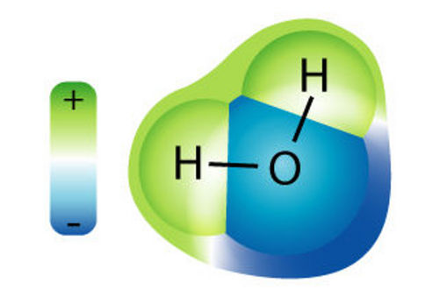
MOST ELEMENTS WANT TO COMBINE NATURALLY, BUT WHAT FORMS WHEN THEY DO?

Slide 3
It Depends…
Molecule = 2 or more atoms joined
(can be the same element or more than one)
Compound = 2 or more different elements joined in a chemical reaction
Mixture = 2 or more substances combined
Solution = A type of mixture that looks the same throughout

Slide 4
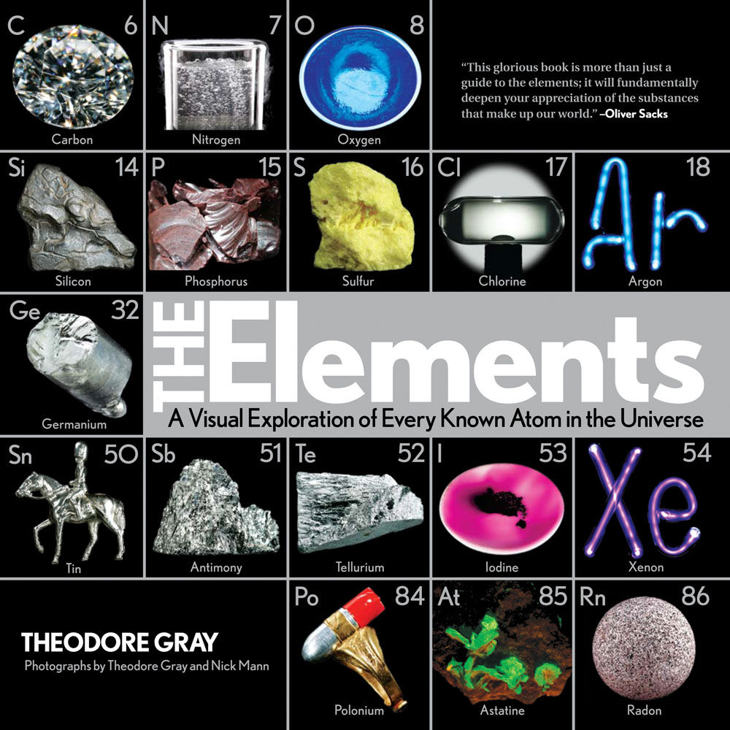
Elements:
Pure substances made of only one type of atom
MUST be on the Periodic Table OF ELEMENTS
Combine to form all other types of matter
Examples:
Silver
Calcium
Oxygen

Slide 5
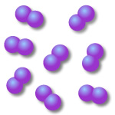
What Does it Look Like Chemically?
Single atoms of ONE pure element
Molecules of ONE pure element

Slide 6
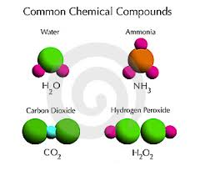
Compounds:
Two or more elements joined during a chemical reaction
Must be combined in specific ratios
Chemical Change/Reaction
Examples:
Water
Salt
Sugar

Slide 7
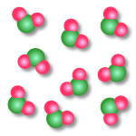
What Does it Look Like Chemically?
2 or more ELEMENTS that are CHEMICALLY bonded to one another

Slide 8
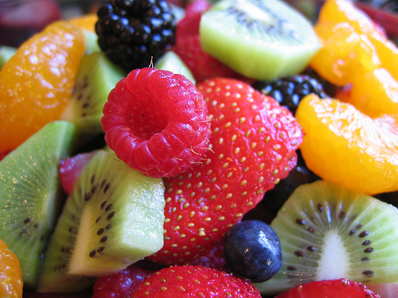
Mixture
Combines 2 or more substances without producing a chemical reaction = PHYSICAL CHANGE
Different throughout = heterogeneous
Basic mixtures can be separated easily
Examples:
Soil
Fruit salad
Taco
BigMac

Slide 9
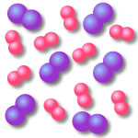
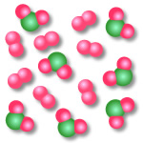
What Does it Look Like Chemically?
2 or more SUBSTANCES MIXED together, but NOT chemically bonded.

Slide 10
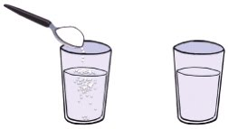
Solution:
A type of HOMOGENOUS MIXTURE - same throughout = STILL A PHYSICAL CHANGE
Can be solids, liquids or gases
Solute- substance being dissolved
Solvent- substance doing the dissolving
Examples:
Salt water
Lemonade
Sweet tea
Salt = Solute
Water= Solvent
Salt Water= Solution

Slide 11
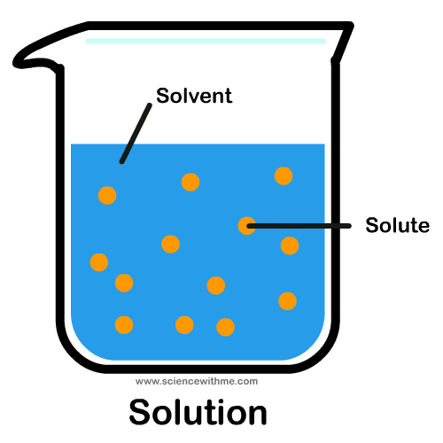
What Does it Look Like Chemically?
It is also a mixture of 2 or more SUBSTANCES, but the particles will be evenly distributed throughout (homogenous)

Slide 12
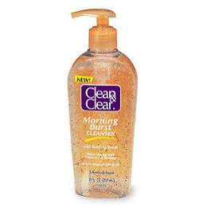
Suspension:
A type of HETEROGENEOUS MIXTURE – different throughout
Particles will not dissolve, (insoluble) or are suspended
Examples:
Face washes, hand sanitizer
Snow globe

Slide 13
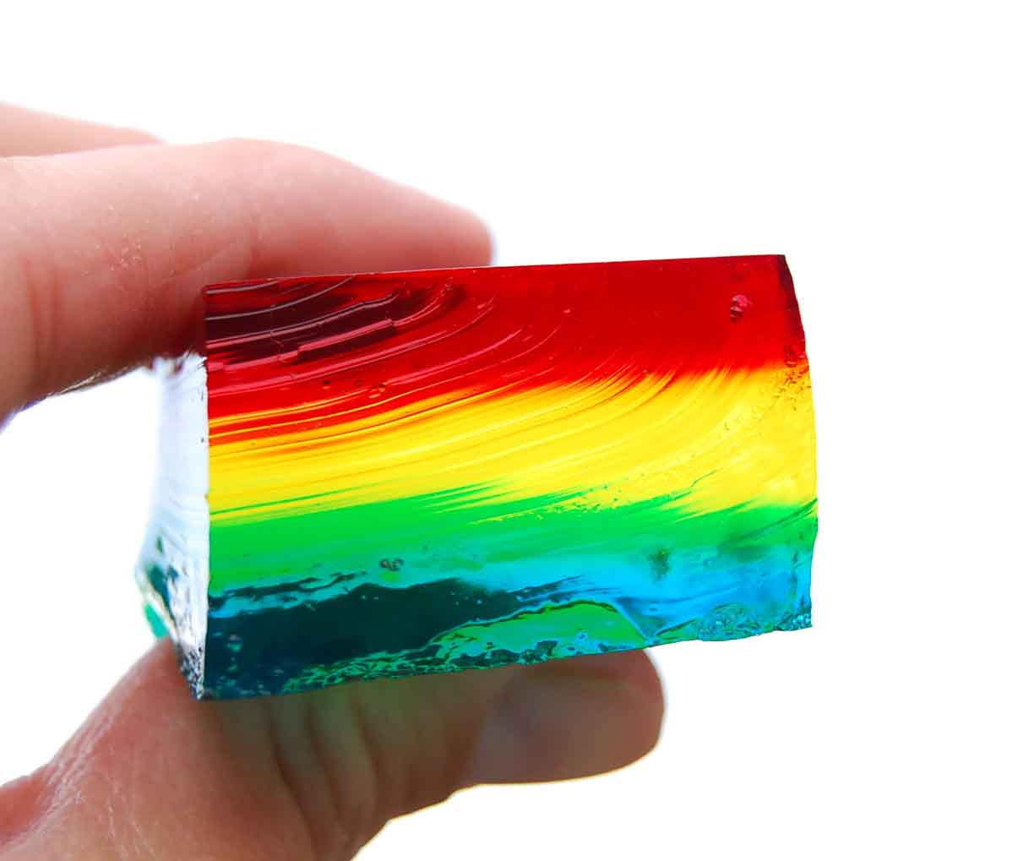
Colloid:
A type of HOMOGENEOUS SOLUTION
Have an “in between” texture
Examples:
Jell-O
Pudding
Milk

Slide 14
Compounds, Mixtures, Solutions
Read the “Compounds, Mixtures, and Solutions article, and use it to answer the questions.
You may read & complete the questions with your table/group.

Slide 15
Quick Comprehension Stations
Visit each station and describe what you see using as many vocabulary terms from the article as you can…I want scientific explanations – (that means use vocabulary!!)
Each station has multiple explanations…ticket time!!

Slide 16
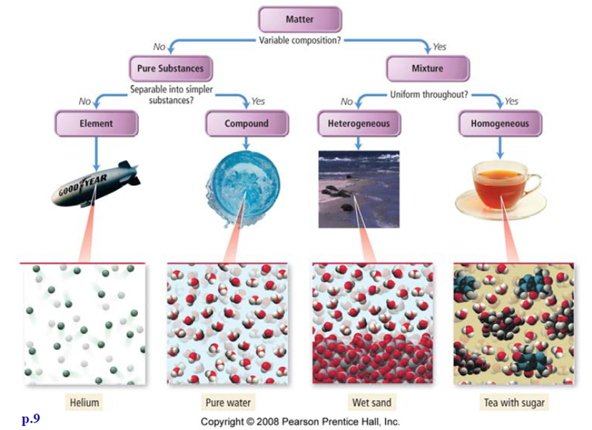

Slide 17
Vocab to Help with the Warm-Up
Heterogeneous = different throughout
Homogeneous = same throughout
Molecule = at least 2 atoms bonded together
Compound = at least 2 different atoms bonded together
Mixture = at least 2 substances mixed; heterogeneous
Solution = at least 2 substances mixed; type of mixture that is homogeneous

Slide 18
In it to WIN it!
I will show you a picture and you will have 15 seconds to figure out what it is and write it down on your white board…YOU GET ONE CHANCE!
Your answer will be one of the following:
Element = E
Compound = C
Mixture = M
Solution = S

Slide 19
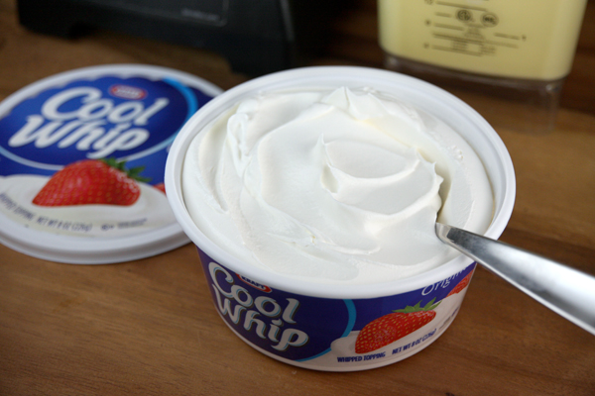
Element, Compound, Mixture or Solution?
Cool Whip

Slide 20
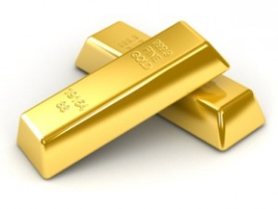
Element, Compound, Mixture or Solution?
Gold

Slide 21
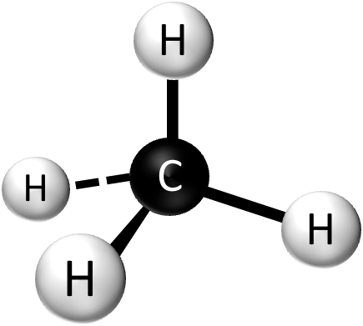
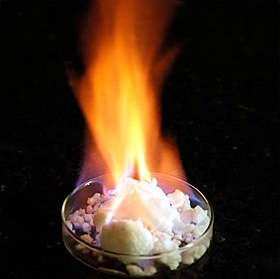
Element, Compound, Mixture or Solution?
Methane – CH₄

Slide 22
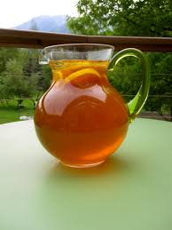
Element, Compound, Mixture, or Solution?
Sweet Tea

Slide 23
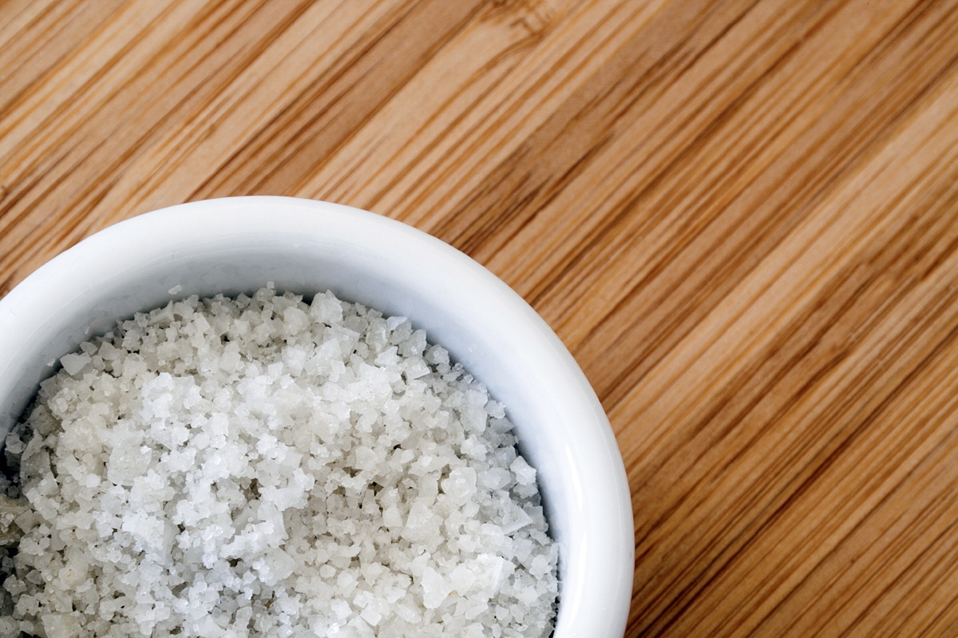
Element, Compound, Mixture, or Solution?
Salt

Slide 24
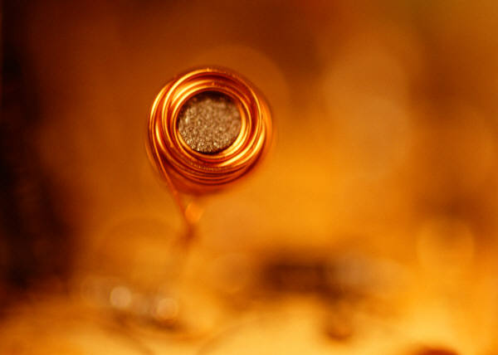
Element, Compound, Mixture, or Solution?
Copper

Slide 25
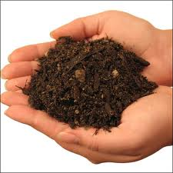
Element, Compound, Mixture, or Solution?
Soil

Slide 26
Element, Compound, Mixture, or Solution?
Water

Slide 27
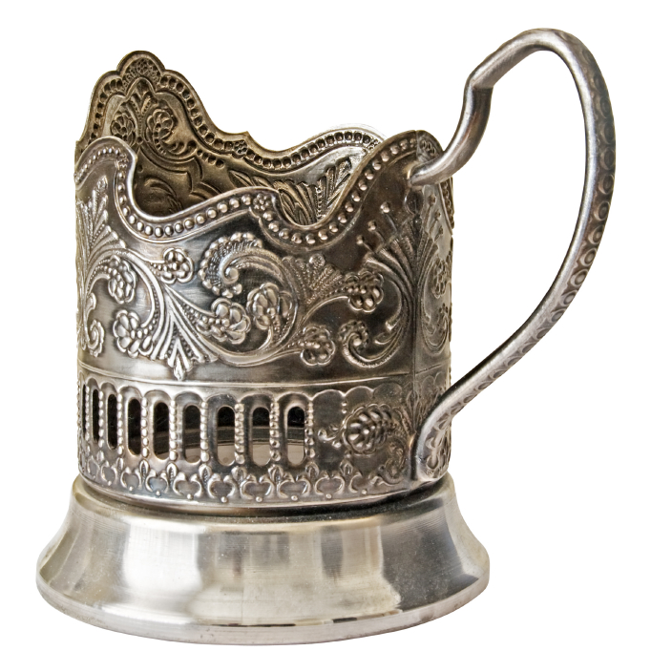
Element, Compound, Mixture, or Solution?
Silver

Slide 28
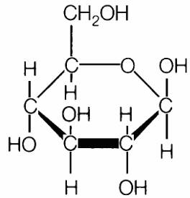
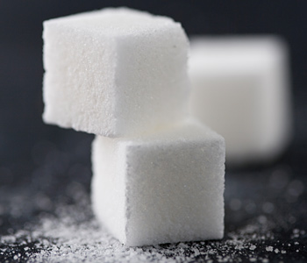
Element, Compound, Mixture or Solution?
Sugar
=

Slide 29
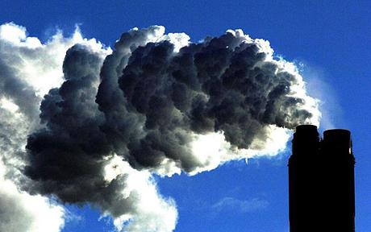
Element, Compound, Mixture, or Solution?
Air

Slide 30
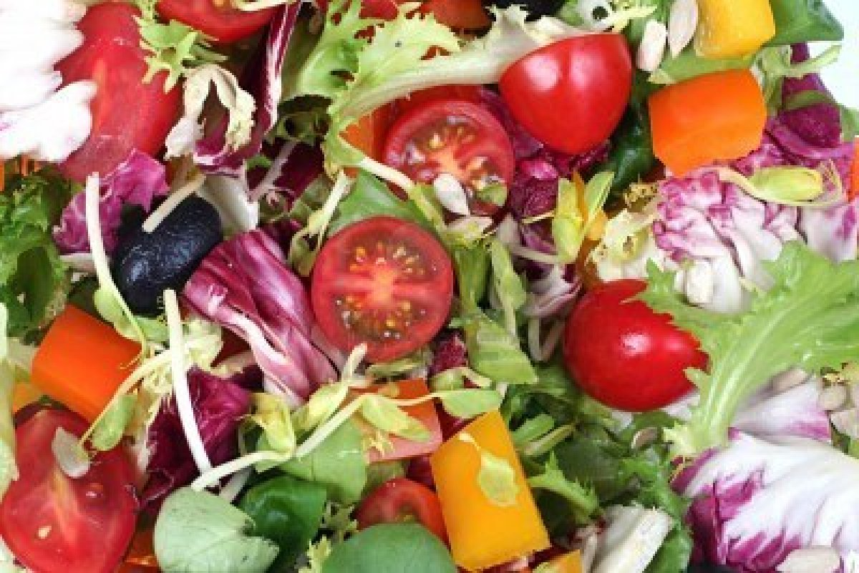
Element, Compound, Mixture, or Solution?
Salad

Slide 31
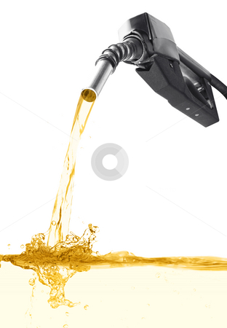
Element, Compound, Mixture, or Solution?
Gasoline

Slide 32
Element, Compound, Mixture, or Solution?
Neon Gas in the Sign

Slide 33
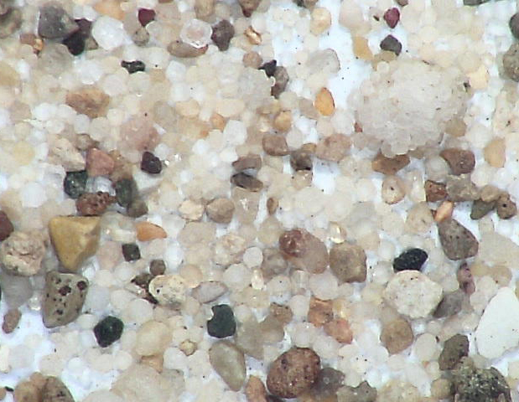
Element, Compound, Mixture or Solution?
Pebbles

Slide 34
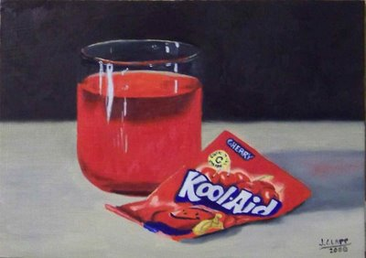
Element, Compound, Mixture, or Solution?
Kool-Aid

Slide 35
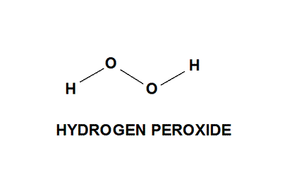
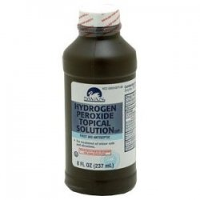
Element, Compound, Mixture, or Solution?
Hydrogen Peroxide

Slide 36
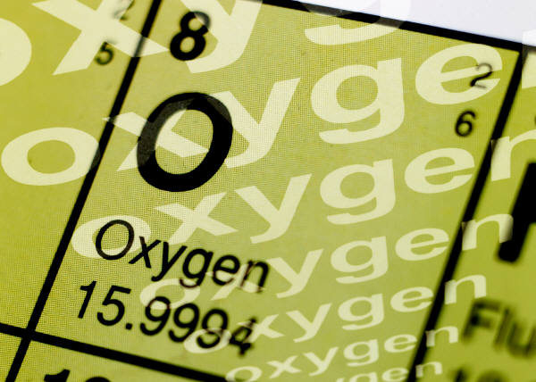
Element, Compound, Mixture, or Solution?
Oxygen

Slide 37
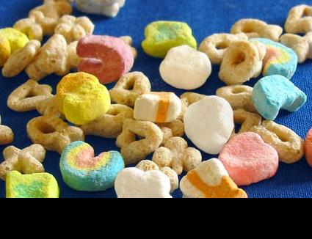
Element, Compound, Mixture, or Solution?
Lucky Charms Cereal

Slide 38
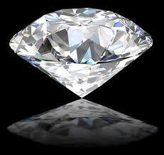
THE LAST CHALLENGE!
Diamond

Slide 39
“Sum It Up” – Ticket out the Door
Read the directions and complete the “Sum It Up”
Make sure your name is on it, make sure it is legible, and make sure it is in the basket before you walk out the door!

