Slide 1
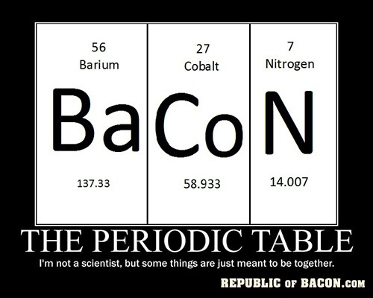
Bell work 9/29
Turn in AOW in the box (if completed)
Bell work- 5 min
“Why is the periodic table arranged the way it is?”
Discuss with your table groups and make a list of ideas/patterns in your bell work section.

Slide 2
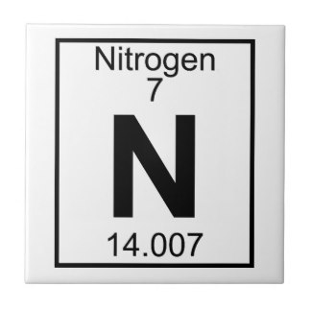
Element Tile

Slide 3
Review
Neutral Atoms
Ions??
Isotopes??

Slide 4
Periodic Table of Elements
8th Grade Science

Slide 5
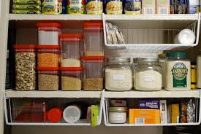
Turn & Talk
What are some different ways you can organize something like your closet or the kitchen cupboards?

Slide 6
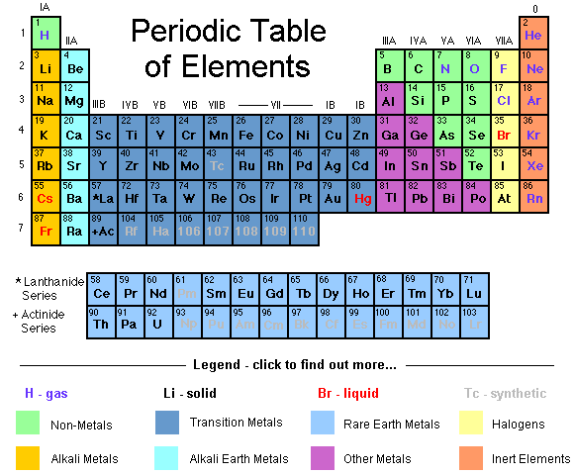
Trends of the Periodic Table
Basic Organization
The Periodic Table of Elements organizes all of the elements based on atomic structure and properties of the elements

Slide 7
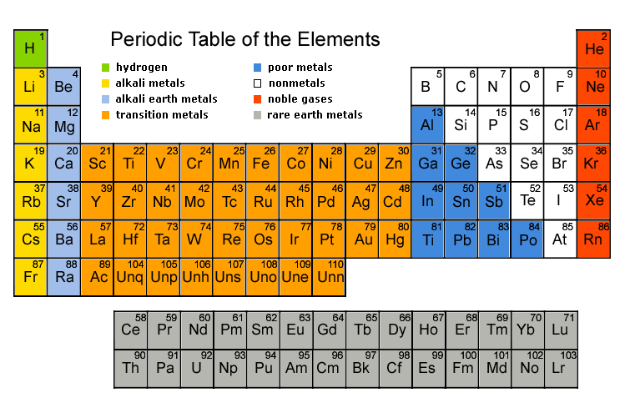
Trends of the Periodic Table
Row (horizontal) = Period across the periodic table
The elements in the same period have the same number of electron shells

Slide 8
Trends of the Periodic Table
Column = Group/Family going down the periodic table
The elements in the same group have the same number of valence electrons…but there is a trick
8
1
2
3
4
5
6
7

Slide 9
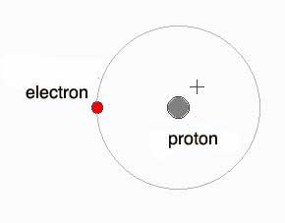
What’s Up With Hydrogen?
Different from any of the other elements
Nonmetal; has 0 neutrons

Slide 10
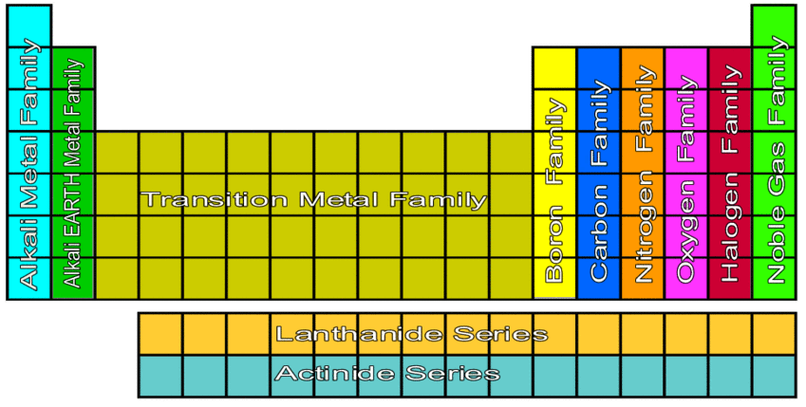
Different Families!
Hydrogen
H
Notes:
Time for about 12 minutes

Slide 11
“Element Band” Poster
Band name (relates to family name)
Band member names (element + property)
5 songs (that relate to the properties of your family)
BOLD THE DESCRIPTIVE WORDS (this is what your classmates will write down)
1 bonus song (that describes the number of valence electrons)
Date and location of next concert

Slide 12
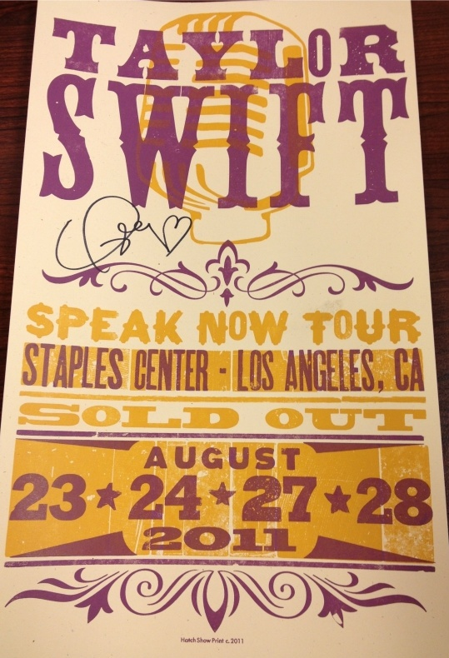
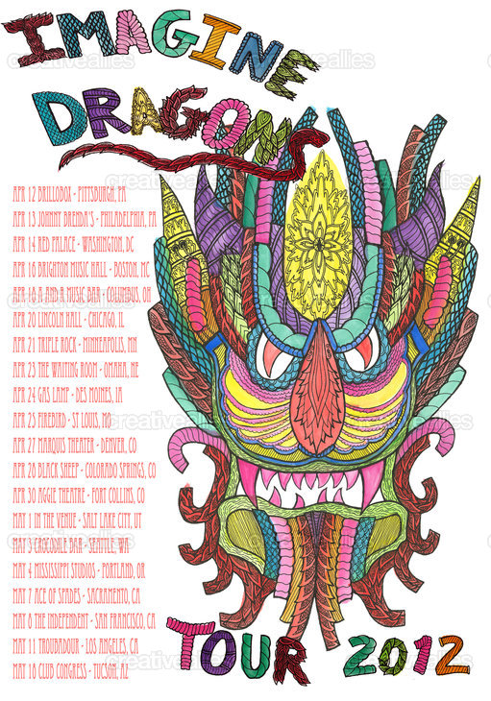
Examples

Slide 13
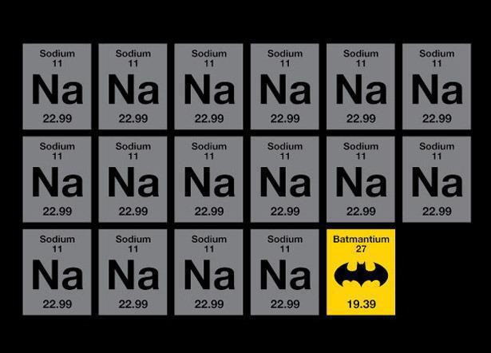
Bell work 10/3
Turn in any late work (AOW or show me your vocabulary if you did not last class)
Sit with Band Group (one group per table)
Begin working on Poster

Slide 14
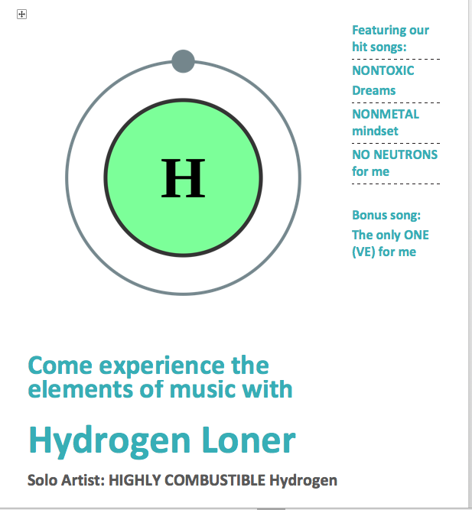
Add Date and Location!
Date: October 24th
Location: 001 1st Column Lane

Slide 15
“Element Band” Poster
Band name (relates to family name)
Band member names (element + property)
5 songs (that relate to the properties of your family)
BOLD THE DESCRIPTIVE WORDS (this is what your classmates will write down)
1 bonus song (that describes the number of valence electrons)
Date and location of next concert

Slide 16
Bell work 10/5
What information do all elements in a period have in common?

Slide 17
The Metals
Reactive Metals
Alkali metals – Group/Family 1
Most reactive; 1 valence electron

Slide 18
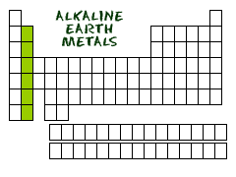
The Metals
Reactive Metals
Alkaline Earth metals – Group/Family 2
2nd most reactive; 2 valence electrons

Slide 19
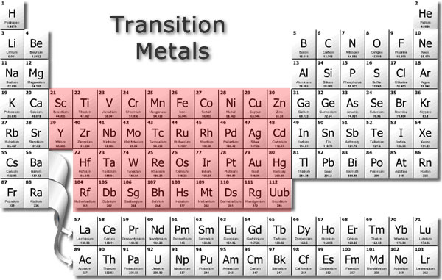
The Metals
Less Reactive Metals
Transition Metals – Groups/Families 3-12
More stable & much less reactive

Slide 20
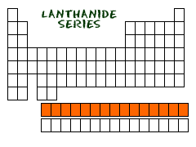
The Metals
Lanthanides – 1st row under the table
Also known as “rare Earth metals” or “inner-transition” elements because they are still found in nature

Slide 21
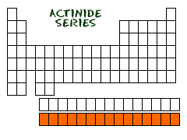
The Metals
Actinides – 2nd row under the table
All are radioactive and some are created in a lab

Slide 22
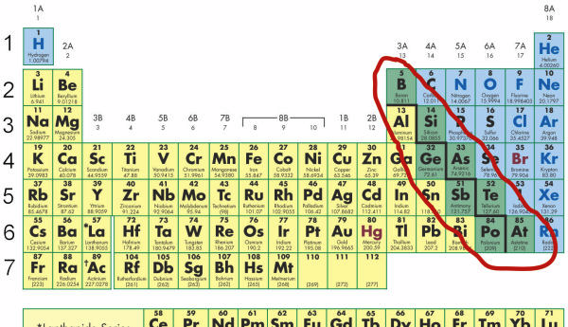
The Metalloids
Metalloids - Found on the zig-zag steps
Have properties of metals and nonmetals

Slide 23
The Blended Families
They are simply named for the element at the top of the group and they contain a combination of elements.
Boron Family = Group/Family 13 (3)
Carbon Family = Group/Family 14 (4)
Nitrogen Family = Group/Family 15 (5)
Oxygen Family = Group/Family 16 (6)

Slide 24
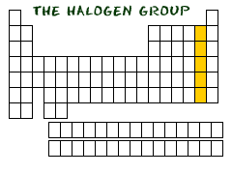
The Non-Metals
Reactive Non-metals
Halogens – Group/Family 17 (7)
Reactive gases; 7 valence electrons

Slide 25
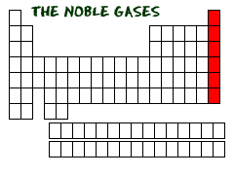
The Non-Metals
Non-Reactive Non-metals
Noble Gases – Group/Family 18 (8)
Inert; full valence shell

Slide 26
Color & Label Your Periodic Table
Hydrogen
H
Notes:
Time for about 12 minutes

Slide 27
Knights of the Periodic Table
Listen to the story and make connections about each group/family…write the uses of each group into the chart on your note guide.

Slide 28
Knights of the Periodic Table
Once upon a time in a land far, far away, there were 3 kingdoms. Each kingdom had it’s own royal “families,” and each family member had their own very unique personality. Like in every family, some of them were very well behaved…and others were quite naughty, but one thing is for sure, every time the family members from different kingdoms came into contact with each other it caused quite a reaction!

Slide 29
Knights of the Periodic Table
There are 3 sections or “Kingdoms” on the Periodic Table:
Metal Kingdom =
Metalloid Kingdom =
Nonmetal Kingdom =
Each character in the story is meant to represent a different group and their unique properties…

Slide 30
The Court Jester
Different from any of the other elements, this guy is a weirdo. He is a simple minded fellow because he has no neutrons to keep him grounded. Even though he is a bit of a loner, he is friendly and therefore bonds with people as he travels through the kingdoms. He is useful as a solo act or along with a other entertainers. Some say he has the answer to clean fuel and energy production in the future.

Slide 31
What’s Up With Hydrogen?
Hydrogen the Court Jester
Different from any of the other elements
Nonmetal with 0 neutrons
USES: Clean fuel/clean energy

Slide 32
Prince AL of the Metal Kingdom
He is one of three brothers in the metal kingdom. He is actually a twin! He is more aggressive than his twin brother and will fight anyone and everyone to defend the family’s honor…so he says. The real reason he is so aggressive is that he feels like his life just isn’t complete and that he is always missing something. Prince Al is also under a lot of pressure from his family because he is skilled at so many things. He is included in the production of foods, medicines, fertilizers and even batteries to keep his Kingdom running. He is crucial in keeping the bodies of all of his subjects healthy and strong.

Slide 33
Prince AL of the Metal Kingdom
Character Description:
Prince Al is very aggressive. He fights anyone and everyone because he feels like he is missing something and wants to feel complete.
Periodic Table Connection:
Represents Group 1: Alkali Metals
Most reactive of all the metals
1 valence electron, always looking to bond to be “happy”
USES: Foods, medicines, fertilizers, lithium batteries

Slide 34
Prince ALAN of the Metal Kingdom
Prince Alan is Al’s twin brother. He is also very aggressive, but not as aggressive as his twin. He also shares the feeling of not being complete. He is also under a lot of pressure from his family to keep the Kingdom running smoothly, and he actually assists Al with a lot of the Kingdom’s medical needs as well as the general health of all of his subjects. But, because he has a slightly more balanced personality he is also in charge of the Kingdom’s celebrations and providing entertainment such as fireworks and flares.

Slide 35
Prince ALAN of the Metal Kingdom
Character Description:
Prince Alan is not as aggressive as his brother Al, but still likes to fight because he also feels he is missing something, and wants someone to bond with.
Periodic Table Connection:
Represents Group 2: Alkaline Metals
Reactive metal but not as reactive as Alkali Metals
Have 2 valence electrons, always looking to bond to be “happy”
USES: cancer treatment & medical imaging, fireworks/flares

Slide 36
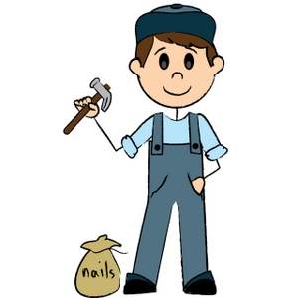
Prince TRAVIS of the Metal Kingdom
Travis, unlike his brothers is always constant and rarely changes. He is the oldest of the three brothers and the most mature. Even though his brothers are useful, their aggressive behavior is hard to control, and Travis is just the opposite. He is laid back and flexible and he focuses on his job as a handyman – fixing problems rather than creating them! He works with the natural resources his Kingdom has to offer to make things like tools, jewelry, coins and items that conduct heat or electricity. He is happy on his own, but when he does find someone to bond with the pair becomes even stronger!

Slide 37
Prince TRAVIS of the Metal Kingdom
Character Description:
Travis, unlike his brothers is always constant and rarely changes. He is laid back and instead he focuses on his job as a handyman – fixing problems rather than creating them!
Periodic Table Connection:
Represent Groups 3-12: Transition Metals
Stable & do not react with most elements
Malleable, ductile & good conductors
USES: combines to make alloys, used to make tools, wires, household items, jewelry etc.

Slide 38
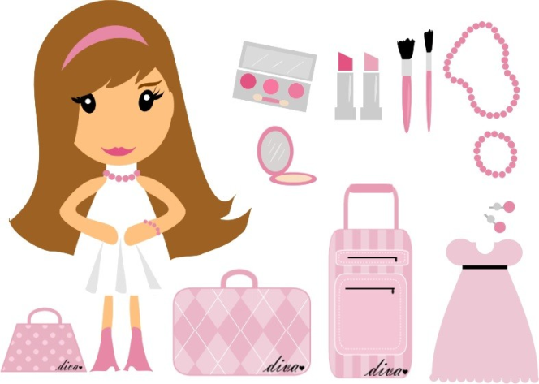
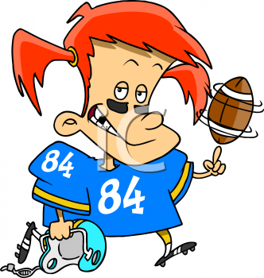
Queen CYBIL of the Metalloid Kingdom
Queen Cybil is an interesting character, she has what we call a split-personality. Sometimes she acts like a “girly girl” and sometimes she acts like a “tomboy.” She changes her personality based on who she is around…the princes of the Metal Kingdom, or the Princesses of the Non-metal Kingdom. She can be quite useful, and has a talent for technology as she is often used as a semi-conductor in electronics. This talent makes her the perfect link between the Kingdoms. Because Cybil plays both sides of the Periodic Table she can be unpredictable unless you know which of her personalities you are dealing with.

Slide 39
Queen CYBIL of the Metalloid Kingdom
Character Description:
Cybil has a split-personality: “girly girl” AND “tomboy.” She changes her personality based on who she is around – Cybil is “two-faced”
Periodic Table Connection:
Have characteristics of both metals and nonmetals – zig zag steps
React differently depending on the element they react with
USES: semiconductors in electronics (silicon)

Slide 40
Princess DARLENE of the Non-metal Kingdom
Princess Darlene is a drama queen because she wants to be “perfect” like her sister Nora the Noble Princess. She is very reactive and always wants the spotlight. She feels like she is so close to being “perfect” but she just can’t quite get there. So, in an attempt to be happy Darlene loves to spend time with Prince Al of the Metal Kingdom. When she is frustrated with his behavior she cleans, and she is known for her special cleaners and detergents. When the two are getting along they make things like salt, but when they aren’t, the relationship can be quite toxic!

Slide 41
Princess DARLENE of the non-metal Kingdom
Character Description:
Darlene is a drama queen because she wants to be “perfect” like her sister Nora the Noble Princess. Darlene loves to spend time with Al of the metal kingdom
Periodic Table Connection:
Represents Group 17: Halogens
Reactive nonmetals
Have 7 electrons in their valence shell…so close to being “happy”
USES: detergents & cleaners, halogen light bulbs

Slide 42
Princess NORA of the Non-metal Kingdom
Nora the Noble Princess is the perfect proper princess. She avoids drama by sticking to herself unless she is needed to help prevent drama among others. Some don’t like her very much because they consider her snobby for not hanging out with anyone, but she is confident in that she doesn’t need others to make her happy and in reality she has a very bright personality that can really light up her Kingdom and of course make her sister Darlene crazy with jealousy!

Slide 43
Princess NORA of the non-metal kingdom
Character Description:
Nora the noble princess is the perfect proper princess. She avoids drama by sticking to herself unless she is needed to help prevent drama among others.
Periodic Table Connection:
Represents Group 18: Noble Gases
Do not react with other elements because their valence shell is full
USES: neon in signs, stopping chemical reactions

